Slide 1


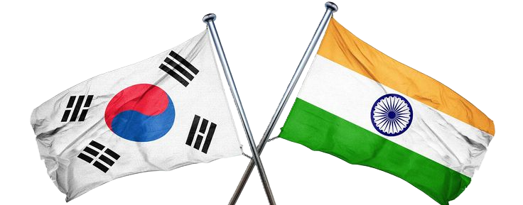


2026 K-Medi Trade Show in India

Slide 2
Program Overview
Welcome & Inaugurations
VB India Overview
Distributors Meeting : General Guidelines
Agenda
  Sep 16th : Distributor Facility Visit and Transit to Mumbai
  Sep 17th : Medical Fair and Dinner
  Sep 18th : Distributor Meeting at ITC and Departures
2

Slide 3

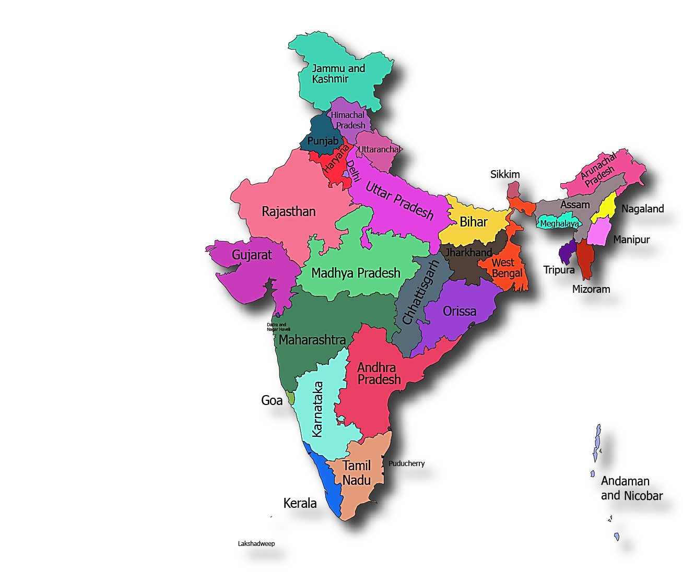
Welcome to India !
3

Slide 4

Lamp Lighting Ceremony

Slide 5





The Go Global partner for healthcare innovation
Market Intelligence
For consulting firms, investment firms,
or healthcare companies
Market Assessment & Entry Strategy
Medical Due Diligence of New Technology
Medical Expert Insights
Market Landscape & Competitive Analysis
Distribution
For corporates,
Licensed in India and Korea
Planning to set up soon in Singapore
Utilizing current healthcare network in medical devices
Go-To-Market Support
For healthcare companies aiming for global expansion
KOL Engagement & Clinical Facilitation
Digital Marketing
Partnership & Business Development
Branding & MarCom
We Work With
Local SMEs (SG focused)
Exploring global expansion
Governments (Mainly KR)
Companies seeking global exposure backed by governments
Corporations (Mainly India/CN)
Searching for new technologies

Slide 6
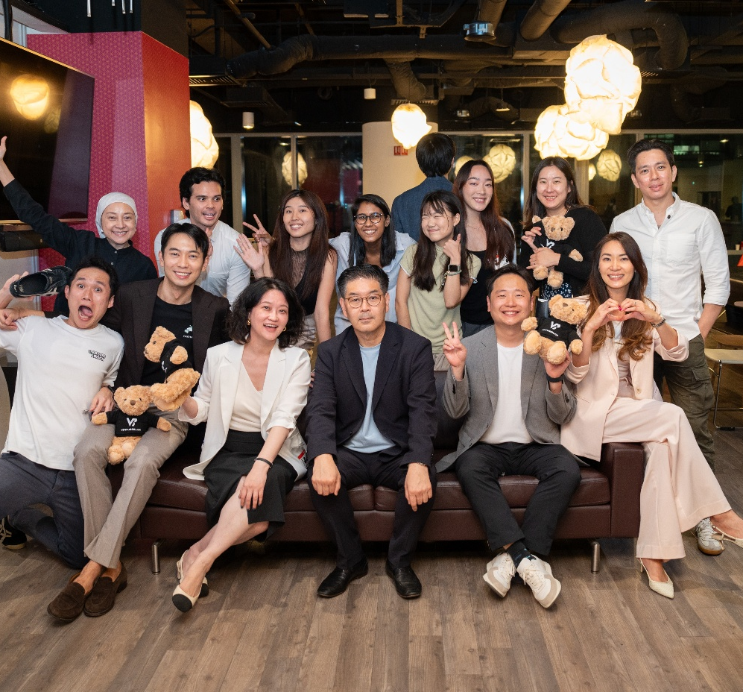
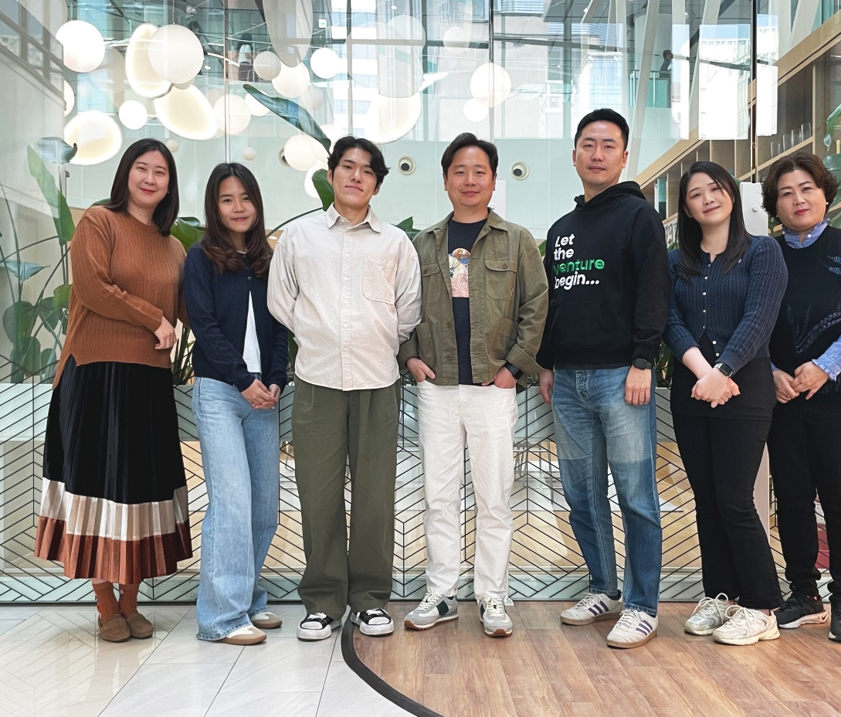
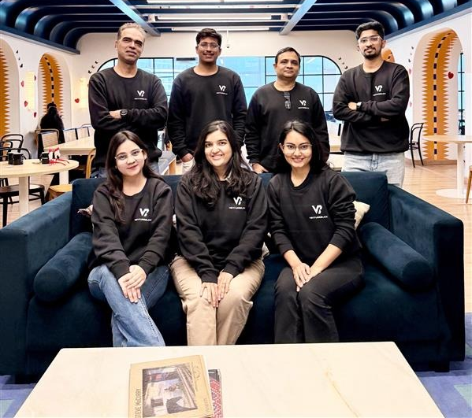
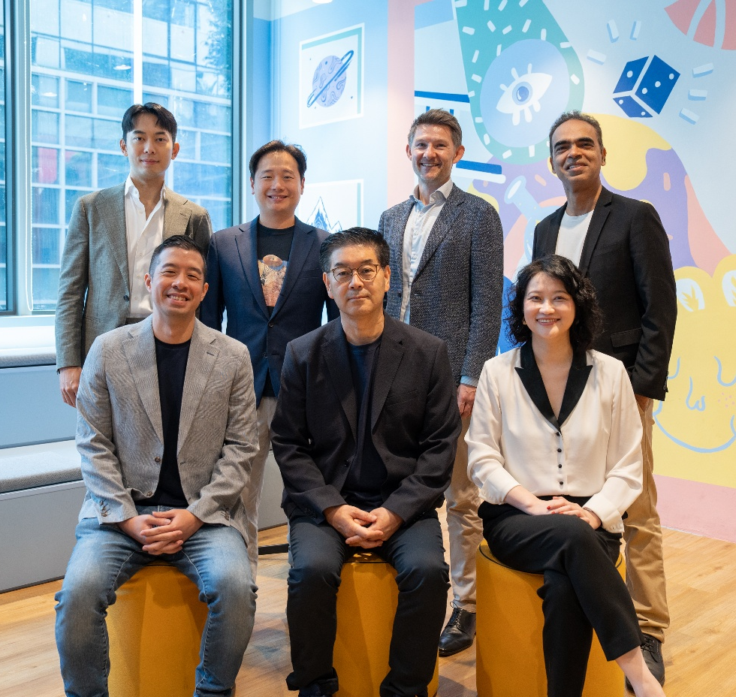
4 locations
Singapore | Korea | India | China
30 employees

Slide 7
VB Journey in India
Progress from Consulting to Execution has been gradual and planned
Set up a franchise of VentureBlick in Sept 2023.
Led 25+ Global MNC/Govt projects up to Jan 2025 onwards
Getting VB Distributor License
Oct 2025
Set up of India Company
Leading Global VB GTM Projects
Pivoted from Consulting to GTM
Develop India’s Distributor Network
June 2025
Considering India execution potential moved to GTM in Jan 2025

Slide 8
Distributors Meeting: General Guidelines
Indian distributor meetings can be relationship-oriented, particularly during the first interaction.
Before the meeting be clear about:
Product positioning & Target customers
Regulatory status
Commercialisation: Customs & Tariffs ,Distributor margin, Pricing ,Demand generation, Channel strategy
Minimum order quantity
Exclusivity expectations
Servicing & Long term commitment -Warranty & After-sales support
During Meeting : Short product presentation/catalogue and, if possible, product samples or demonstration materials.
Waterfall chart
8

Slide 9
Distributors Meetings : Communication Guidelines
During the meeting
Introduction:
Start with a brief introduction and some informal conversation before moving directly into business, Exchange business cards if relevant
Business Culture :
  Indian distributors may ask very direct questions about price, margins, competition, regulatory approval, and sales potential.
  Don't be surprised if they negotiate strongly
  Avoid immediately rejecting a proposal. A response such as "Let us discuss this internally and come back to you" is perfectly acceptable.
  Give confidence on ling term commitment
9

Slide 10
Sep 16th : Distributor Visit and Transit to Mumbai
Sep 16 : Visit to Distribution Facility and Departure to Mumbai
Visit to a Distribution Facility
After breakfast and check-out, assemble in the Lobby at 08:00 am
Travel time to the facility is around 90 mins
Expected arrival at the facility by 10:00 am
The distribution management will brief about the tour & safely measure
We expect around 90 mins for overall visit
Transit to Delhi Airport
Depart for Delhi Airport by 12 pm; the travel time is Approx 1 hour.
Reach the airport by 1:30 pm
Arrival At Mumbai
10

Slide 11
Sep 17th : Medical Fair and Dinner
Travel to NESCO- Convention Centre for Medical Fair
After breakfast and check-out, assemble in the Lobby at 10:00 am
Travel time is around 30-45 mins
Expected arrival at NESCO by 11:00 am
Registration for the event and walk-in
SBA event at Medical Fair
Assemble at booth no: Open Conference Area, Medical Manufacturing Pavilion
17 September 2026 | 3:00 PM – 5:30 PM
Dinner :
Assemble at 7 PM
Travel to OBEROI Mall Goregaon
Dinner @ Copper Chimney Restaurant at 07:00 pm
Travel back to the hotel after dinner
11

Slide 12
Sep 18th : Distributor/Doctor Meeting at ITC and Departures
Distributor Meeting Event
Venue: Dynasty Hall – ITC Maratha, Mumbai
Time: 10:30 – 4:00 PM
Lunch will be served during the event
Departures
Assemble for departure from Hotel ITC at 07:00 pm
Mumbai International Airport Terminal 2
Reporting at the airport at 8 pm
12

Slide 13
Thank you!

Slide 14
2026 K-Medi Trade Show in India

Slide 15
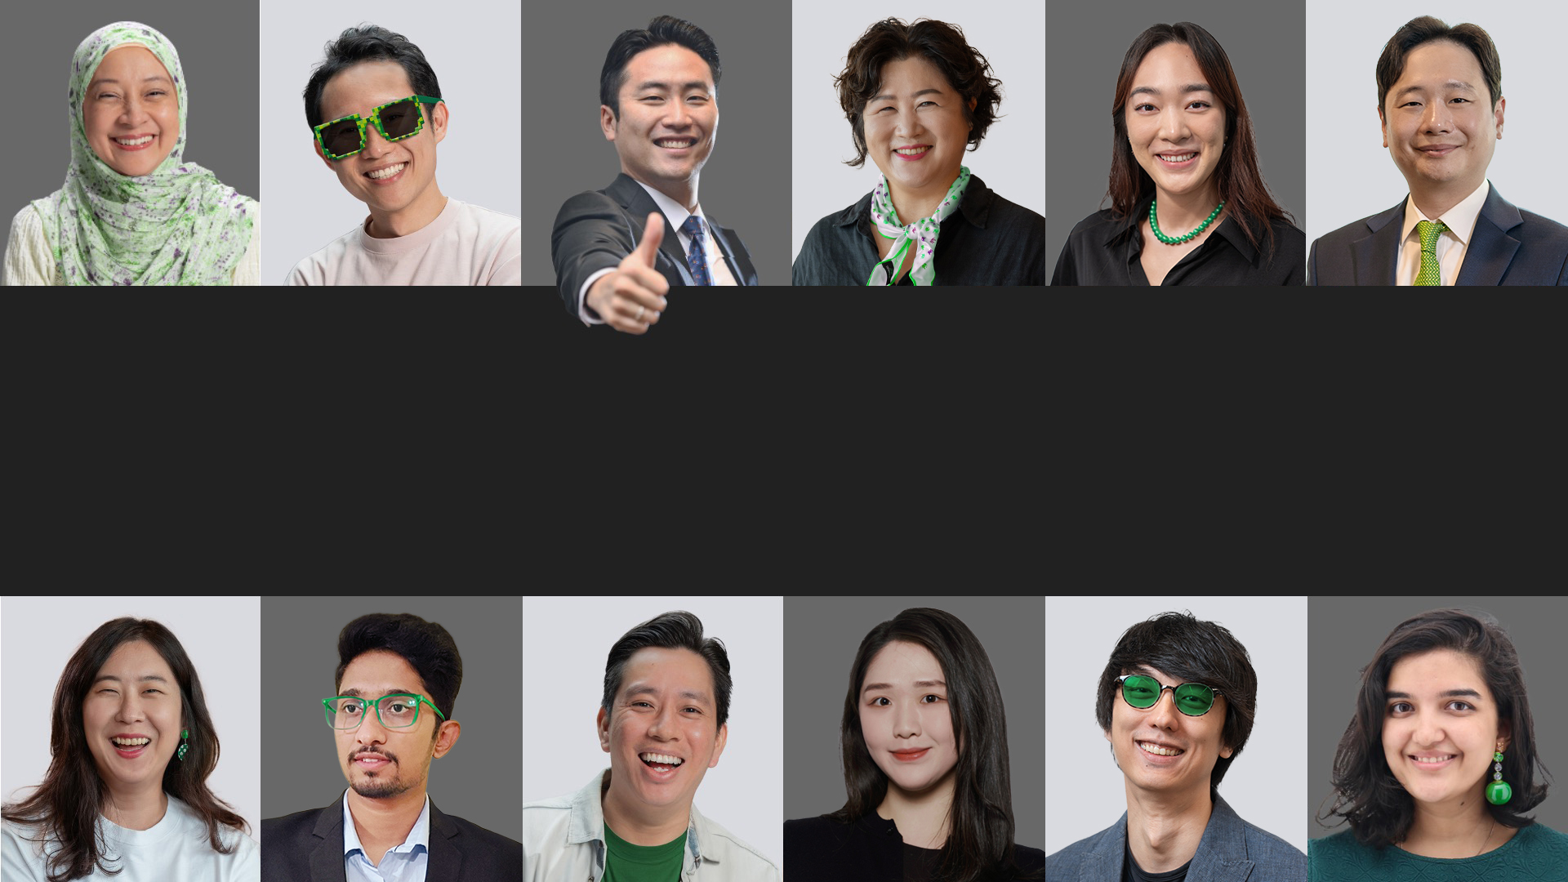

Building Healthcare
Across Borders
Notes:
Scout, Scale, and Speed Up Healthcare Innovations

Slide 16



Healthcare is highly specialised
For innovation to go global, it must be supported by targeted expertise across specialties, markets, and functions.
However, healthcare expertise is scarce
and costly.
This challenge is made worse by geographic, regulatory, and language barriers.
            Specialised knowledge
            Specialised resources
            Specialised connections
Notes:
There’s a tremendous need for global integration and collaboration for healthcare, yet many find it challenging to achieve efficiency.

Slide 17



VentureBlick
The Go Global partner for healthcare innovation, powered by an expert network
What We Offer
We Work With
Leverage Our Global Network
Market Intelligence
Local SMEs
Exploring global expansion
Startups
Seeking global exposure,
often backed by governments
Corporations, Investors, Distributors
Searching for new technologies
6,500+
4
Go-To-Market Support
Healthcare experts in 60+ countries, 30+ specialties
Countries with VB teams on ground
Tech Scouting
800+
Incubation & Acceleration
Local partners: distributors, manufacturers, government agencies, investors, service providers

Slide 18
Go Global Solutions powered by
a specialised expert network
Market Intelligence
For consulting firms, investment firms,
or healthcare companies
Market Assessment & Entry Strategy
Medical Due Diligence of New Technology
Medical Expert Insights
Market Landscape & Competitive Analysis
Distribution and Local Partnerships
For corporates, and MSMEs
Scout partners
Validation of partner credibility
Negotiation and Deal Closure
Go-To-Market Support
For healthcare companies aiming for global expansion
KOL Engagement & Clinical Facilitation
Digital Marketing
Partnership & Business Development
Branding & MarCom
Incubation & Acceleration
For government agencies
supporting local startups
Startup Incubation Programmes
Overseas Acceleration Programmes
Global Market Expansion Programmes

Slide 19





Some of our Key Government Partnerships
Awarded the Accelerator License by the Ministry of SMEs and Startups of Korea
Appointed as the only official accelerator for Global Expansion Program in healthcare by multiple Korea Government Agencies
Appointed as one of the only two official Accelerators in MedTech by Singapore government
Appointed as a Program Partner of the Singapore AI Healthcare Canadian Technology Accelerator Program by the Global Affairs Canada's Trade Commissioner Service

Slide 20


































Our Clients
Corporations
Governments & Research Organisations
Startups & SMEs
Notes:
Added SNUH, Ministry of SMEs and Startups, Snip, KMDIA, Micro-Tech
Removed non-paying startups: DCGen, BeauBrain, Monit, Medical AI, AITRICs, CnC Tech

Slide 21
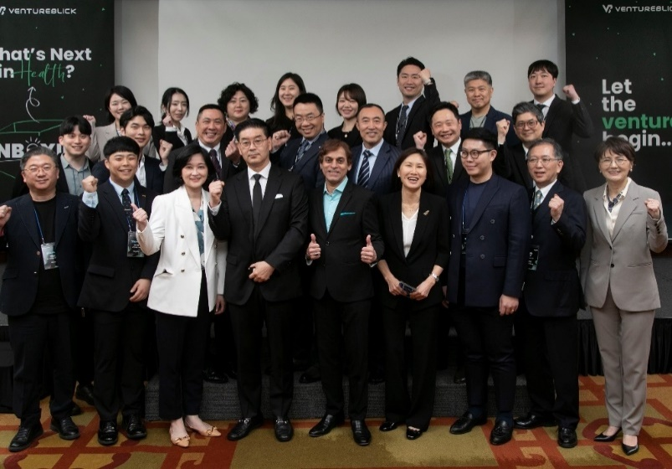
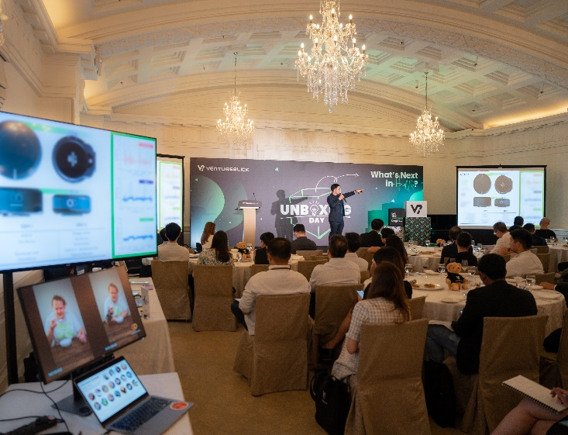
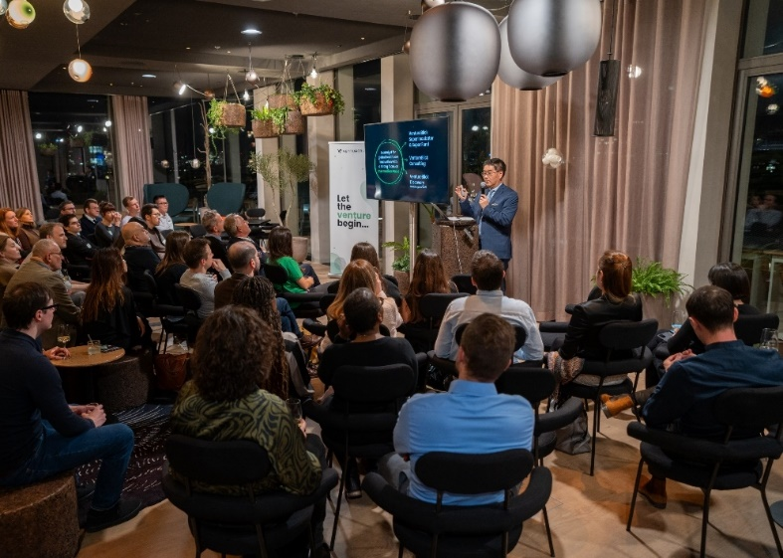
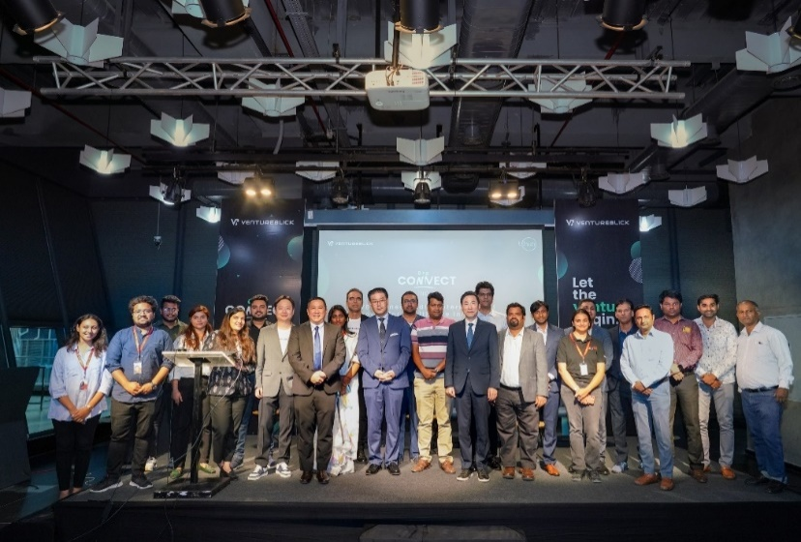
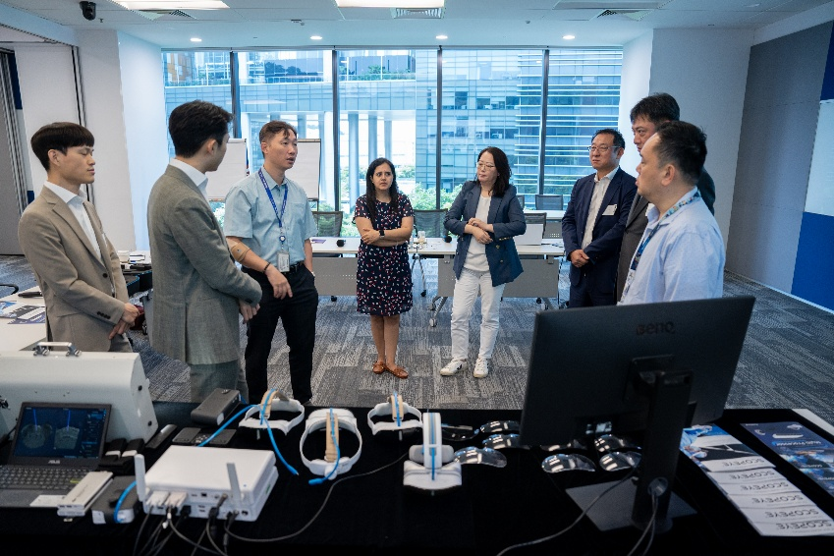
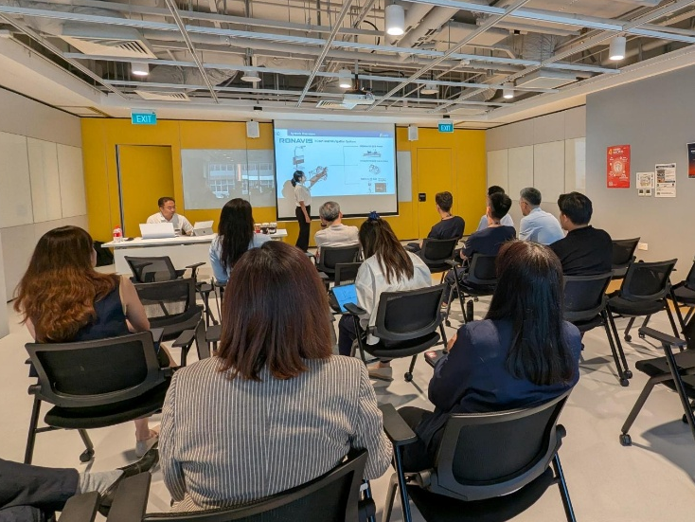
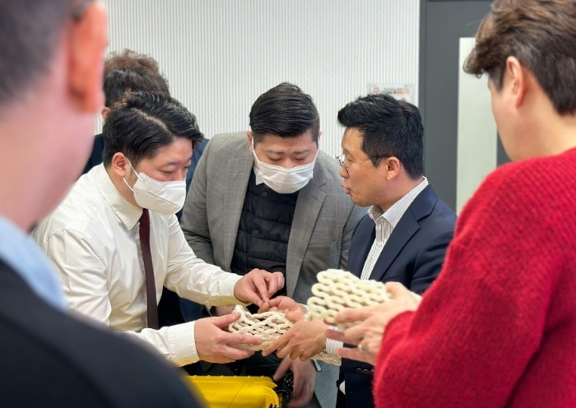
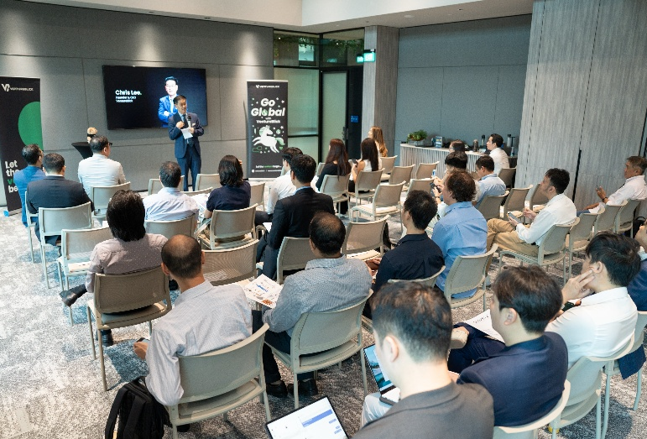
Bringing local innovations to the global stage
VB Unboxing Day – Korea (Apr 2023)
VB Unboxing Day – Singapore
(Apr 2023)
VB Connect Event - Europe
(Nov 2023)
VB Connect Event - India
(Mar 2024)
Demo session with MNC (Jan 2024)
Distributor Showcase – Korea
(April 2024)
Investor Showcase – Singapore
(Feb 2025)
Clinical demo with leading hospital (Jul 2025)

Slide 22

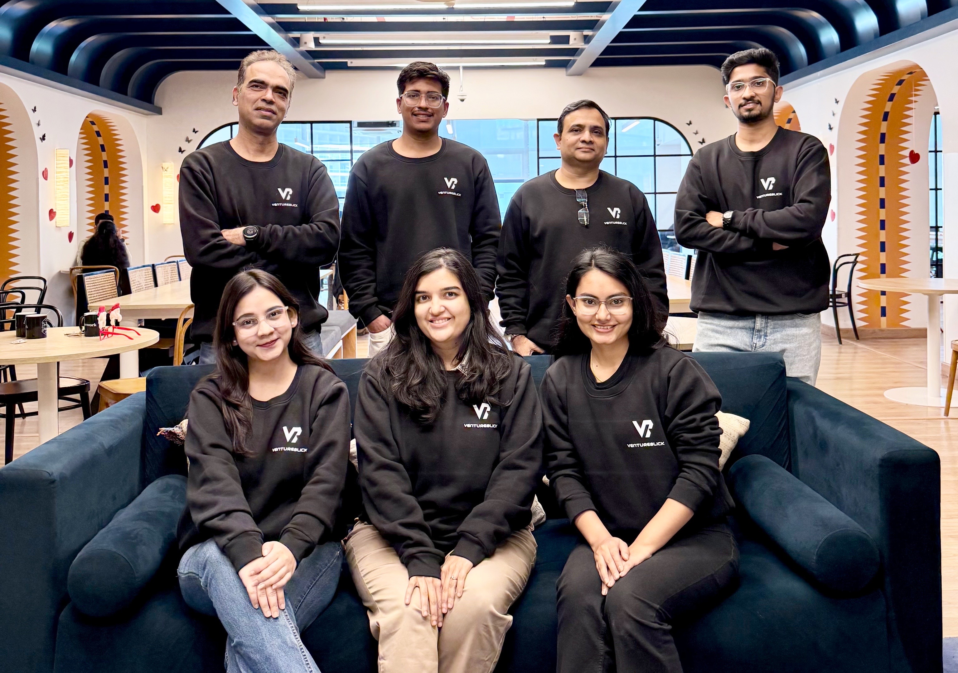
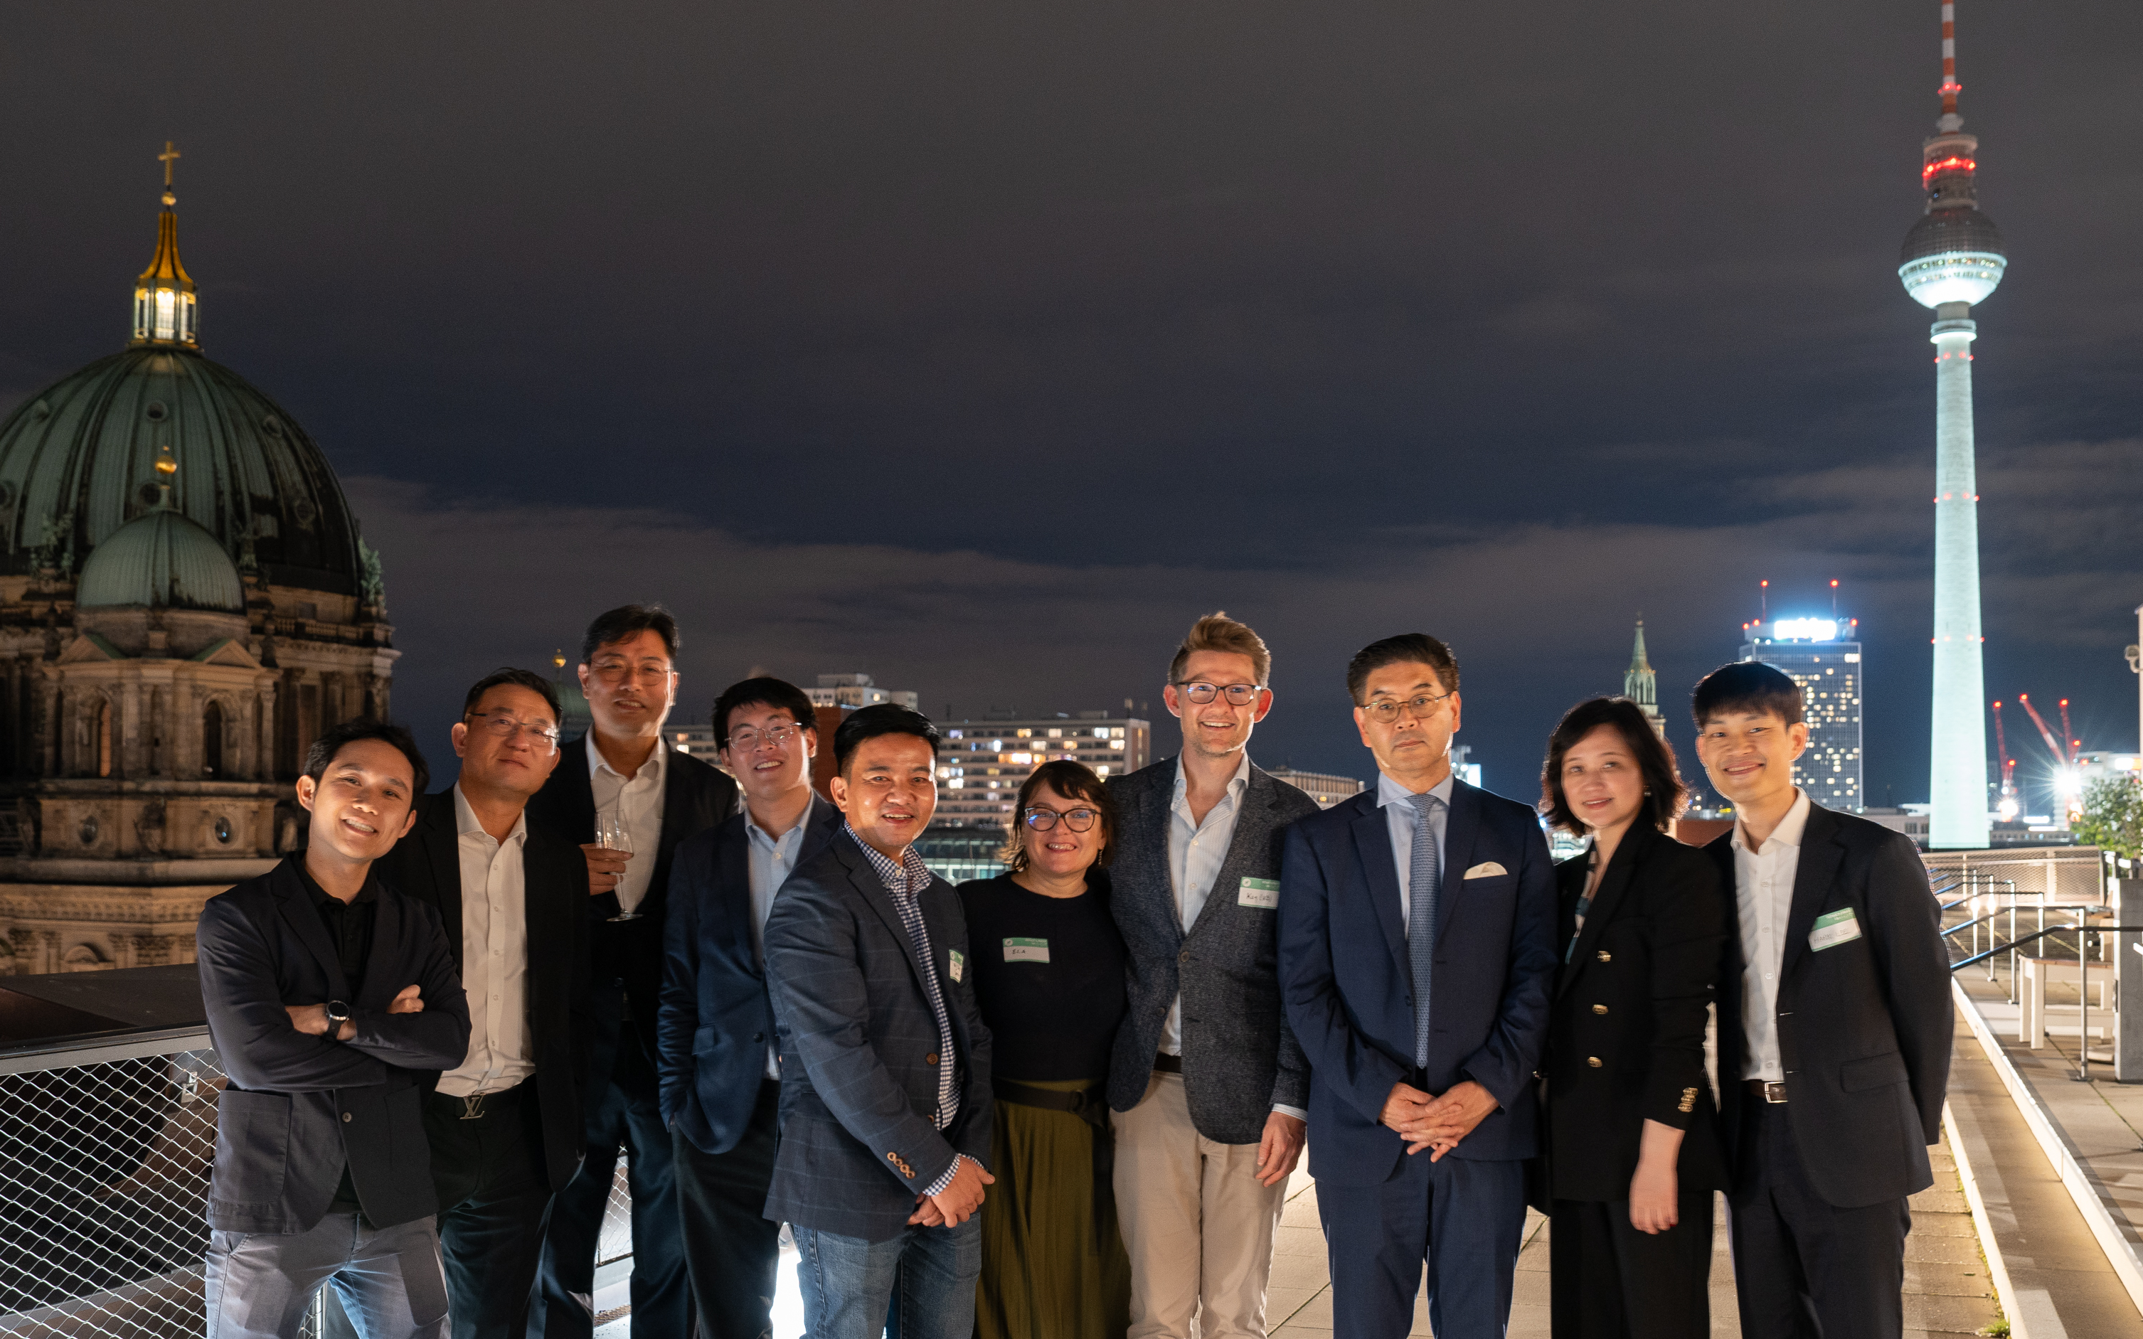

4 locations
Singapore | Korea | India | China

Slide 23
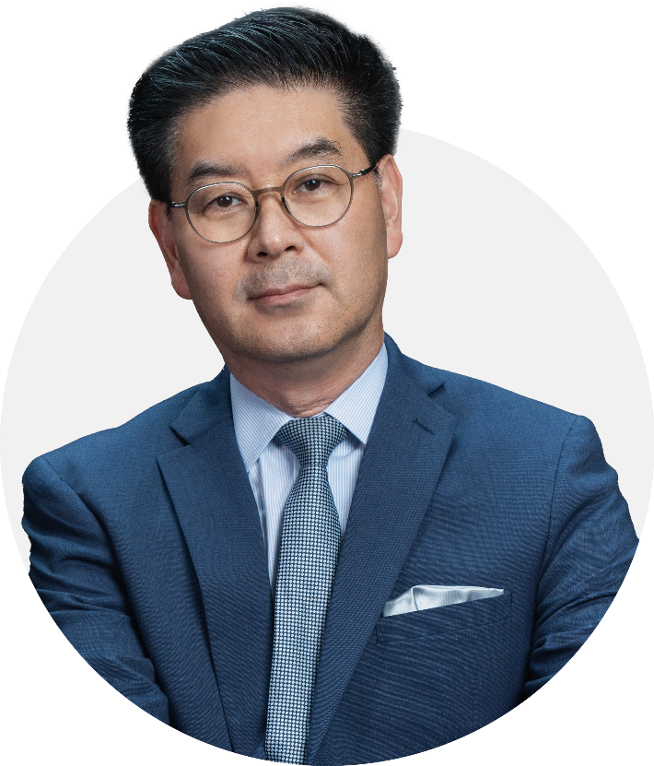

Our Founder
30+ years in healthcare with leading pharma and medtech companies (Medtronic, MSD, BMS, Bayer)
First Asian leader reaching ExCom status in two Fortune 500 healthcare companies
Former APAC President for Medtronic (US$4B revenue, 10,000 employees) and former Bayer Healthcare APAC Head
First Asian ExCom leader in Bayer’s 150-year history, moving Bayer China from No. 10 to No. 1 in 18 months
Started as a sales rep in the US, having worked in 10 countries on 3 continents, appointed as Country Manager of BMS at age 30
Strong track record across M&As, strategic partnerships, new market expansion, and startup incubation
The “Most Respected CEO” for three consecutive years (2020-2022)
Chris Lee
Founder & CEO, VentureBlick

Slide 24
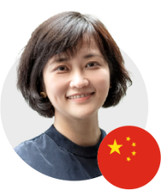
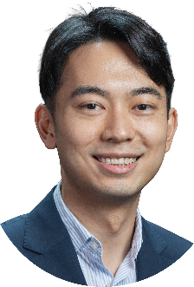
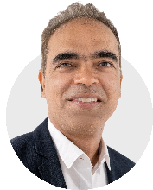
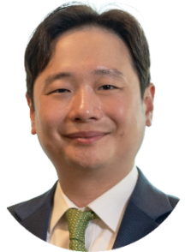




VB Leadership Team
Anita Cai
Chief Marketing & Comms Officer
25+ years in healthcare branding & communications
VP of Corp. Affairs & Education, Medtronic APAC
GM, Edelman China Healthcare
Qinhan Tan
Director, Corporate Strategy & BD
15 years in medtech (private and government sectors)
Healthcare & Biomedical Development Partner, Enterprise Singapore
Roche Diagnostics, Tosoh, Romer Labs
Kevin Yeo
Managing Director, Korea
15+ years in healthcare
Covidien and Medtronic
Award-winning sales and business development professional
Kailash Jialdasani (MD)
Head of Operations,
South Asia
25+ years in healthcare
Abbott Diabetes: Head of Sales, India, Country Head, Singapore; Marketing Head, APAC and Japan
Pediatric physician
Mead Johnson Nutrition,
Apollo Hospitals

Slide 25





ventureblick.com
ventureblick
Disclaimer: Confidential and Proprietary Information
This presentation contains confidential and proprietary information belonging to VentureBlick. It is intended solely for the use of the individual or entity to whom it is addressed and may contain privileged and confidential information. If you are not the intended recipient, you are hereby notified that any dissemination, distribution, or copying of this presentation, or any action taken or omitted to be taken in reliance upon it, is strictly prohibited. If you have received this presentation in error, please notify the sender immediately and delete this presentation from your system. All rights, including copyright, to this presentation are reserved by VentureBlick. No part of this presentation may be reproduced, distributed, or transmitted in any form or by any means, including photocopying, recording, or other electronic or mechanical methods, without the prior written permission of VentureBlick. VentureBlick does not guarantee the accuracy, completeness, or timeliness of the information contained in this presentation, and accepts no liability whatsoever arising from any use or reliance on this presentation or its contents.

Slide 26
2026 K-Medi Trade Show in India
Join us for lunch!
Mumbai | 18 September 2026, ITC Maratha | 10:30 AM–4:00 PM

